Slide 1
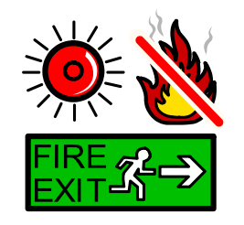
Fire drill social story

Slide 2
Sometimes at school we have fire drills.

Slide 3
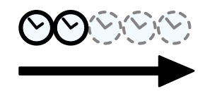
They are only practice. Usually, fire drills only last a short time.

Slide 4
Really there is not a fire.

Slide 5
But I have to practice just in case. This means that I will know how to keep safe, in case of a real fire.

Slide 6
The alarm is really loud.

Slide 7
When I hear the alarm,

Slide 8
I must stop my work.

Slide 9
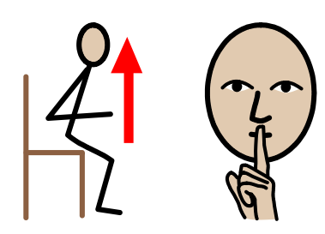
I must get up quietly from my seat.

Slide 10
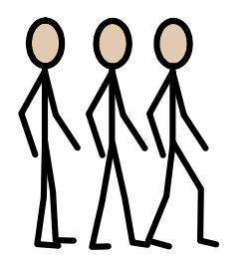
I must line up with my class.

Slide 11
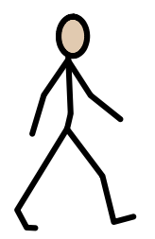
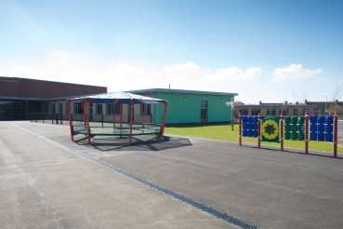
I need to walk outside with my teachers, quickly and calmly.

Slide 12
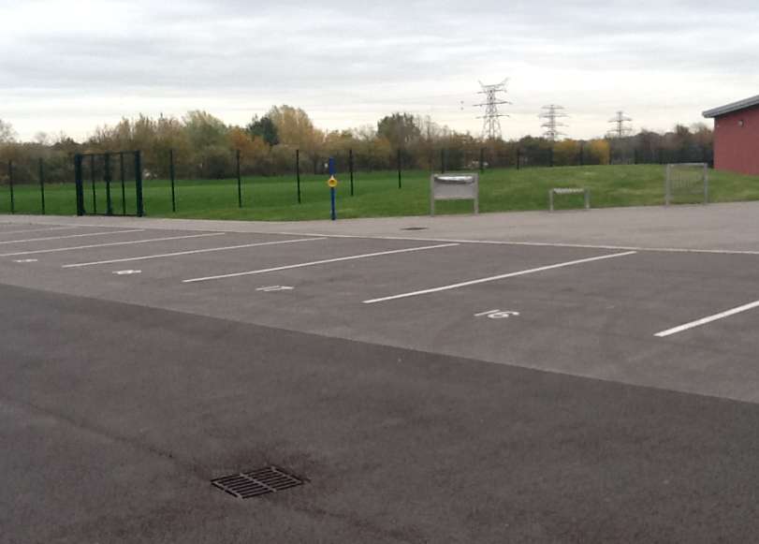
I need to line up with my class on the playground, so my teachers know I am safe.

Slide 13
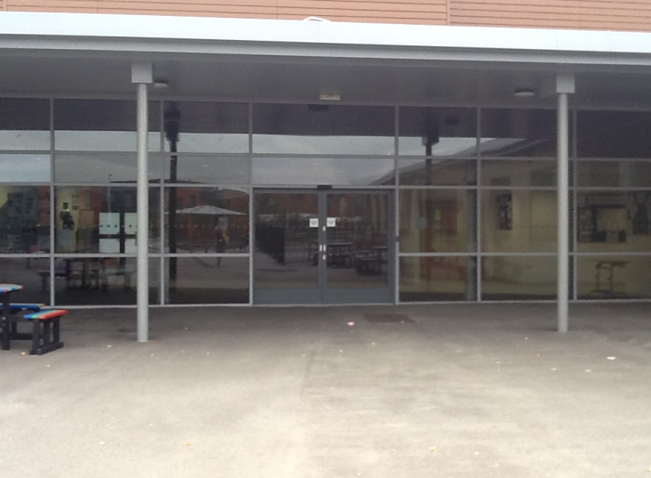
When the teacher tells me it is safe, I can walk back inside school.

Slide 14
Fires are dangerous.

Slide 15
But practicing fire drills keeps everyone safe.

